Slide 1
Dark Matter; Modification of F(R) or Wimps Miracle
Master’s Thesis Defense Presentation
2013 Jan 15
Ali ÖVGÜN
Supervisor: Prof. Dr. Mustafa Halilsoy

Slide 2
Acknowledgement
I would like to express my deep gratitude to
Prof. Mustafa Halilsoy , my supervisor, for his patient guidance, enthusiastic encouragement and useful critiques of this research work.
I would also like to thank Assoc.Prof. Izzet Sakalli, for his advice and assistance in keeping my progress on schedule.
My grateful thanks are also extended to
Prof. Ozay Gurtug, Asst. Prof. Habib Mazharimousavi and Asst. Prof. Mustafa Riza.
Finally, I wish to thank my officemates and friends for their support and encouragement throughout my study.

Slide 3
Sections
1. Introduction to Dark Matter
2. f(R) Gravity and its relation to the interaction between DM
3. WIMPs Miracle
4.Conclusion

Slide 4
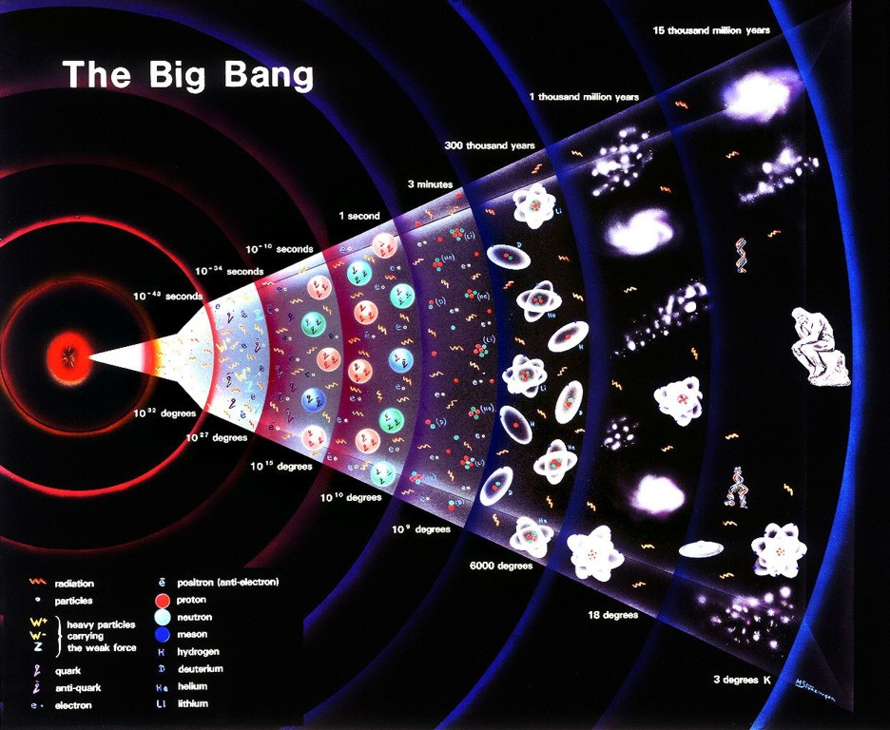
1. Introduction to Dark Matter

Slide 5
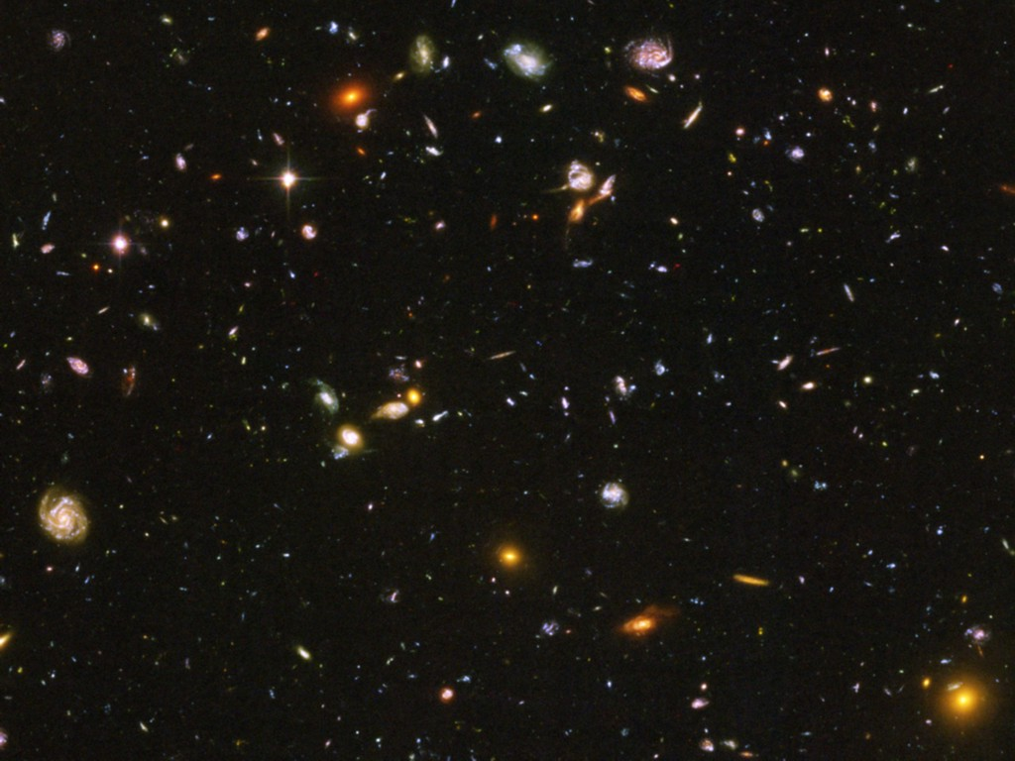
Title
Dark Energy 73%
(Cosmological Constant)
Neutrinos
0.1−2%
Ordinary Matter 4%
(of this only about
10% luminous)
Dark Matter
23%

Slide 6
Dark Matter
Look at:
Our galaxy.
Other galaxies.
Pairs of galaxies.
Clusters of galaxies.
Mass due to gravity.
Mass indicated by luminosity.
Same?
No! → Dark Matter.

Slide 7
Evidence for Dark Matter
Use the fact that massive objects, even if they emit no light,
exert gravitational forces on other massive objects.
m₁
r₁₂
m₂
Study the motions (dynamics) of visible objects like stars
in galaxies, and look for effects that are not explicable by
the mass of the other light emmitting or absorbing objects
around them.

Slide 8
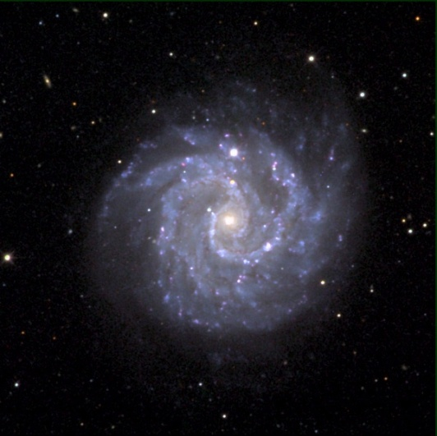
Mass and Luminosity
Most mass gives off light.
Amount of light tells how much mass is present.
Where there’s more light, there is more mass.
More light from galaxy centers vs. edges.
Conclude more mass in center vs. edges.

Slide 9
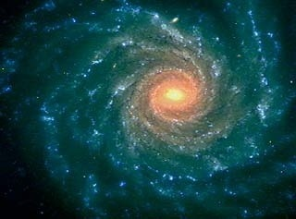
Sun’s Rotation Speed Around Milky Way
In the milky way, all stars rotates around the center of the galaxy
According to Newton’s gravitational theory，the rotation speed of the sun depends on the mass distribution and the distance to the center
According to this formula, the
Rotation speed of the sun
Shall be around 170km/s, however
The actual speed is about 220
-250km/s.
r
v(r)

Slide 10
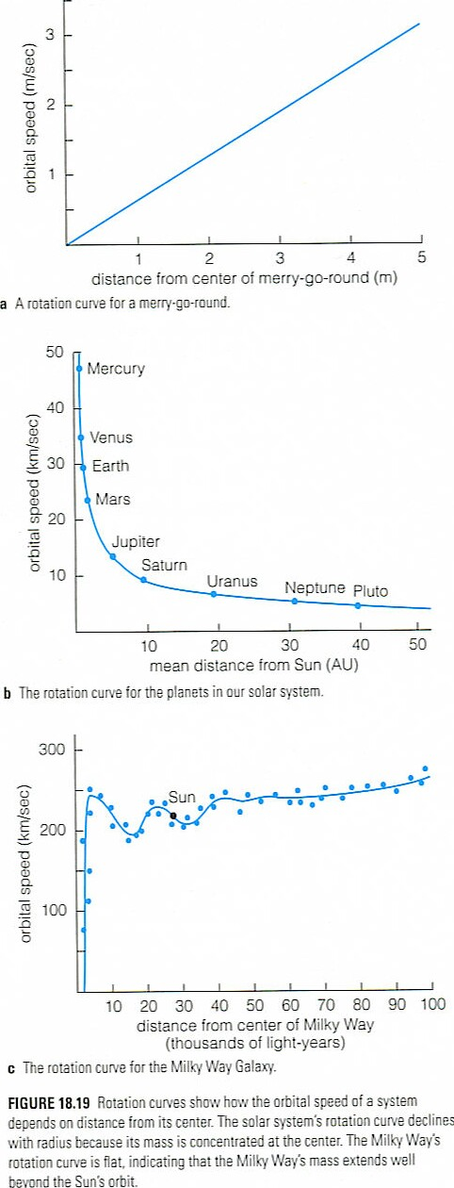
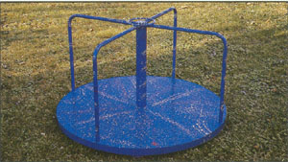
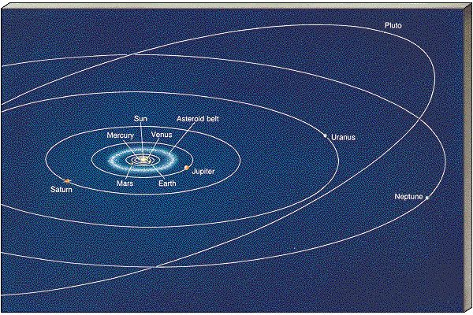
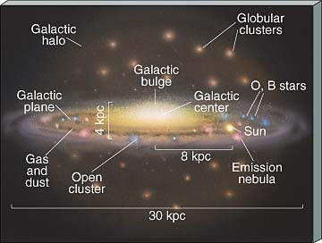
Examples of Rotation Curves

Slide 11
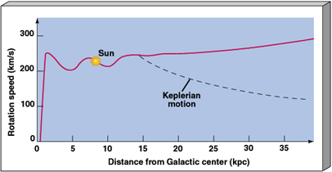
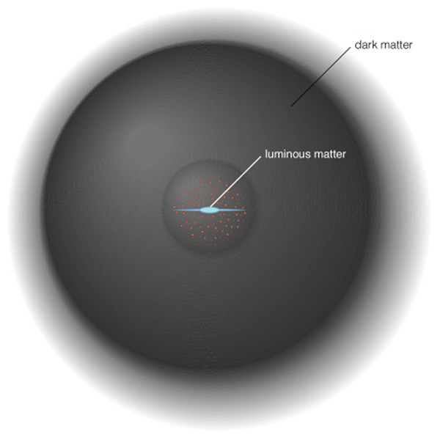
What do we see?
From variable stars we know distances.
From Doppler shift we know rotation velocity.
Edges of Milky Way go too fast.
Must be extra mass near edges of galaxy.

Slide 12
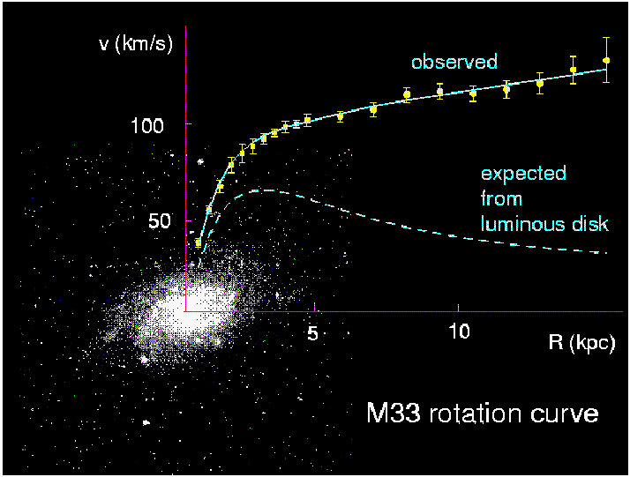
Evidences — galaxy scale
From the Kepler’s law, for r much larger than the luminous terms, you should have v∝r^{-1/2} However, it is flat or rises slightly.
The most direct evidence of the existence of dark matter.
Corbelli & Salucci (2000); Bergstrom (2000)

Slide 13
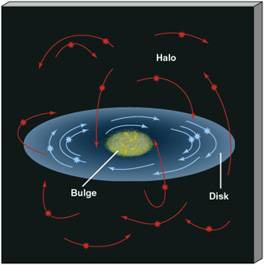
Galaxy Rotation
Objects in the disk, orbit in the disk.
Kepler’s Third Law gives the total mass in orbits.
Basically, it states that the square of the time of one orbital period (T²) is equal to the cube of its average orbital radius (R³). (1 AU = 150,000,000 km)

Slide 14
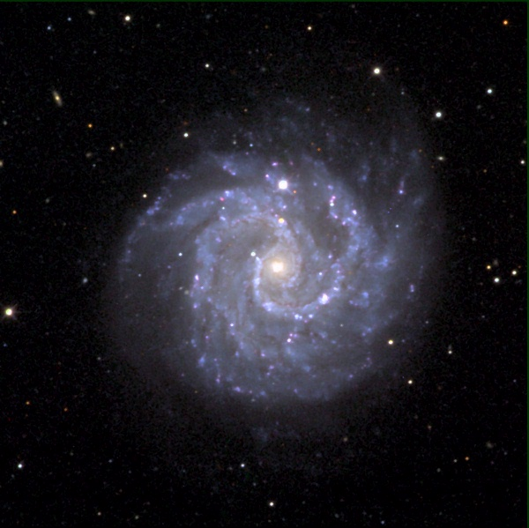
Distributed Mass
In Kepler’s Law, the total mass is the mass “inside” the orbit.

Slide 15
Even More Galaxy Masses
Look for gravitational lenses near galaxy clusters.
More lensing means more mass.
Compare mass from lensing to luminosity.

Slide 16
Local Dark Matter Density
The DM density in the “neighborhood” of our solar system was first estimated as early as 1922 by J.H. Jeans, who analyzed the motion of nearby stars transverse to the galactic plane. He concluded that in our galactic neighborhood, the average density of DM must be roughly equal to that of luminous matter (stars, gas, dust).
Remarkably enough, the most recent estimates, based on a detailed model of our galaxy, find quite similar results
ρ_{local DM} = 0.3 GeV/cm³;
This value is known to within a factor of two or so.

Slide 17
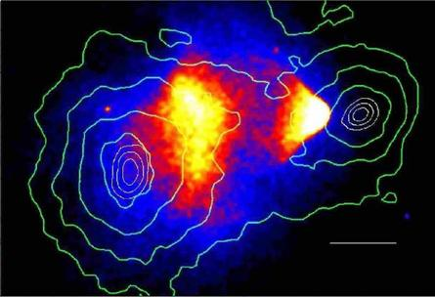
Bullet Cluster

Slide 18
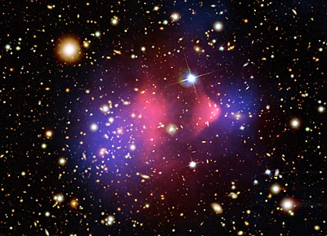
Bullet Cluster

Slide 19
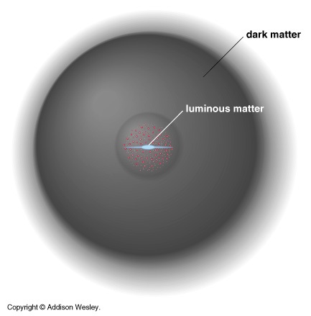
The Correct Way to Think about Our Galaxy

Slide 20
Question:
Is the mass in the universe all observable through
emmission or absorbsion of electromagnetic radiation ?
Dark Matter
...is matter that does not shine or absorb light, and has
therefore escaped direct detection by electromagnetic
transducers like telescopes, radio antennas, x-ray satellites...
It turns out that there is strong
experimental evidence that there is more
than 4 times as much dark matter as
luminous matter in the observable universe

Slide 21
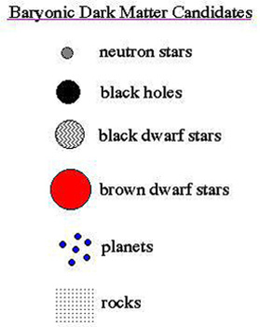
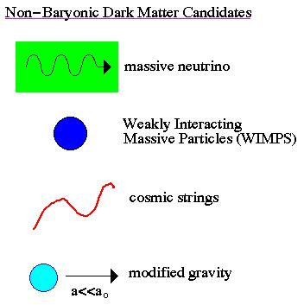
Possible Dark-Matter Candidates

Slide 22
What we learned
In the universe there exists non-baryonic, non-hot, dark matter

Slide 23
What Could Constitute the Dark Matter (1)?
IDEA 1 : Rocks
from pebbles to giant planets like Jupiter.
If there are enough of them, they could make
up the dark matter.
Jupiter-size and above planets are a serious contender,
and are called MACHOs by the community - MAssive
Compact Halo Objects.
IDEA 2: Neutrinos
Light, neutral particles of which at least some have a small
mass. Produced in enormous numbers in stars and possibly
at the big bang. If there are enough of them, they could
(maybe) be the dark matter.

Slide 24
What Could Constitute the Dark Matter (2) ?
IDEA 3: Black Holes
Don’t emit significant amounts of light, can be
very massive. Would need lots of them.
IDEA 4: Cosmic Strings
Dense filamentary structures that some theorists think
could thread the universe, giving rise to its present-
day lumpiness. Currently disfavoured by cosmological data,
but may come back into vogue sometime.

Slide 25
What Could Constitute the Dark Matter (3) ?
IDEA 5: Axions
Very light particles, mass around 1/1,000,000,000,000
of an electron. Needed for building most realistic models
of the neutron from standard model particle physics. Not
detected. To be the dark matter, there should be around
10,000,000,000,000 per cubic centimetre here on Earth.
IDEA 6: WIMPS (for the rest of this talk)
Particles having mass roughly that of an atomic nucleus,
could be as light as carbon or as heavy as 7 nuclei of xenon.
Need a few per litre to constitute dark matter. Unlike nucleus,
only interact WEAKLY with other matter, through the same
mechanism that is responsible for nuclear beta-decay.

Slide 26
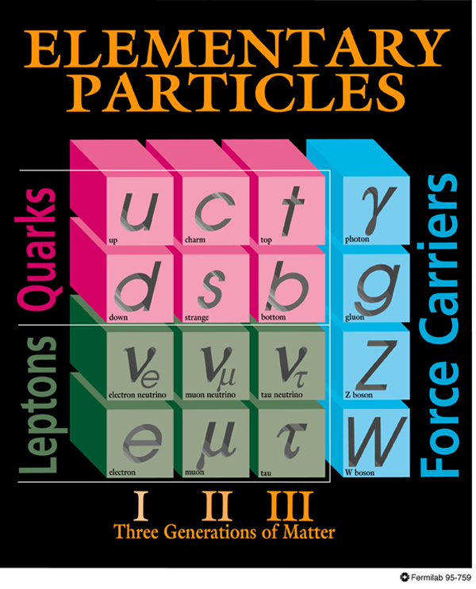
DARK MATTER
Known DM properties
Gravitationally interacting
Not short-lived
Not hot
Not baryonic
Unambiguous evidence for new particles

Slide 27
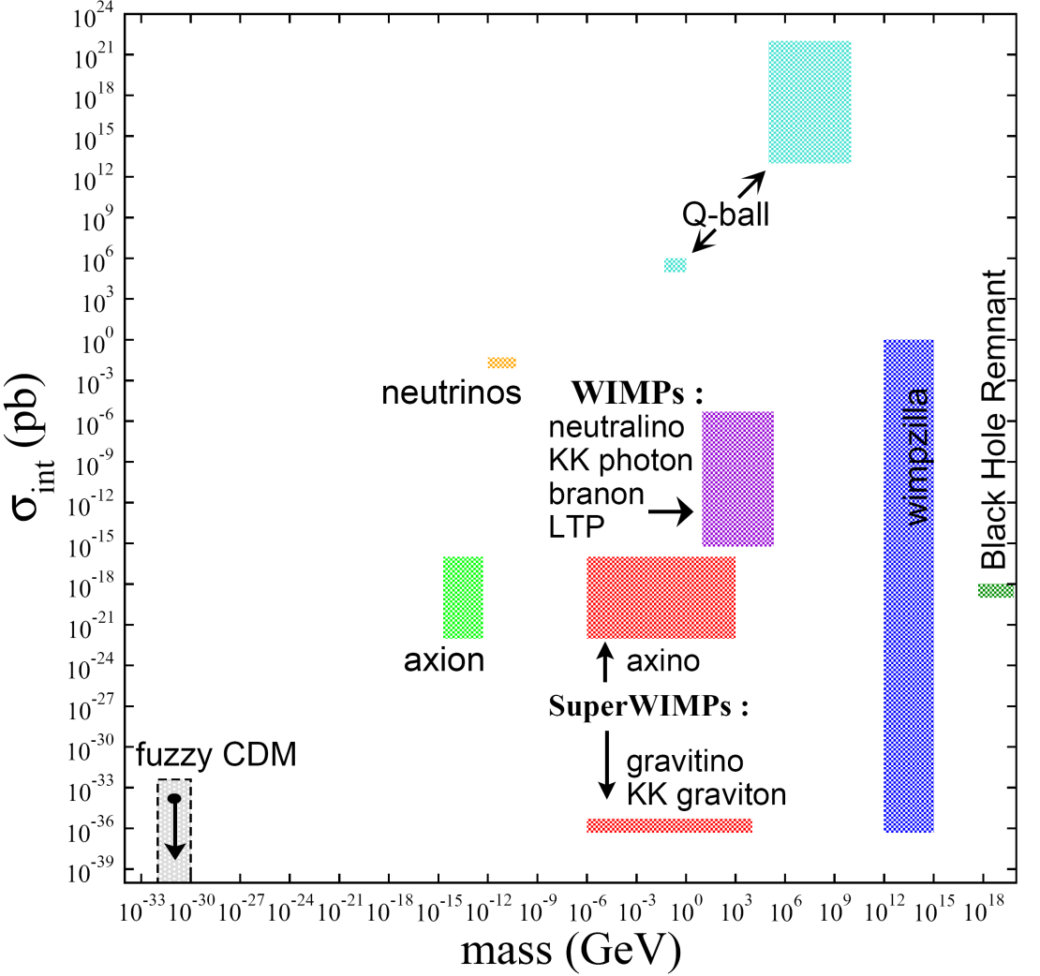
DARK MATTER CANDIDATES
There are many
Masses and interaction strengths span many, many orders of magnitude, but the gauge hierarchy problem especially motivates Terascale masses
HEPAP/AAAC DMSAG Subpanel (2007)

Slide 28
Modified Newtonian Dynamics (MOND)
In 1983, Milgrom proposed a modified Newtonian dynamics in which F=ma is modified to F=maµ, which µ is 1 for large acceleration, becomes a/a0 when a is small.
To explain the rotational curve, one can choose

Slide 29
Problems with MOND
Cannot fit into a framework consistent with GR.
Hard to describe the expansion history, therefore the CMB fluctuation and galaxy distribution.
Hard to explain the bullet cluster.
No MOND can explain all gravitational anomalies without introducing DM.

Slide 30
From particle physics
WIMP(Weakly interacting massive particles)
is a natural dark matter candidate giving correct relic density

Slide 31
WIMP hypothesis
Weakly Interacting Massive Particle
WIMPs freeze out early as the universe expands and cools
WIMP density at freeze-out is determined by the strength σ_{x} of the WIMP interaction with normal matter
Leads to σ_{x} ~ σ_{weak interaction}

Slide 32
What we DO NOT know…
The WIMP mass Mx
prejudice 10<Mx<10000 Gev/c²
The WIMP Interaction Cross-Section
Prejudice σ∼σ_{weak}
(give or take several orders or magnitude…)
The nature of the interaction
Spin coupling?
Atomic Number coupling?

Slide 33
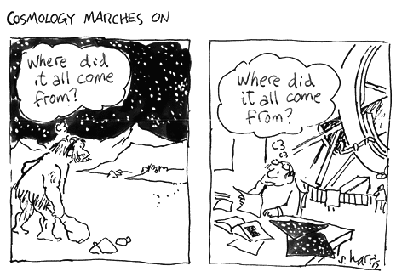
earth, air,
fire, water
baryons, νs,
dark matter,
dark energy
We live in interesting times: we know how much there is, but we have no idea what it is
Precise, unambiguous evidence for new particle physics

Slide 34
f(R) Gravity and its relation to the interaction between DM
At f (R) theory , the main idea is to take action as a function instead of a constant curvature.
f(R) gravity was first proposed in 1970 by Buchdahl (although φ was used rather than f for the name of the arbitrary function).
It has become an active field of research following work by Starobinsky.

Slide 35
‘Changing gravity’ models
f(R) gravity
Dark matter may originate from some geometric
modification from Einstein gravity.
The simplest model:
f(R) gravity
R: Ricci scalar
model:
f(R) modified gravity models can be used for dark matter ?

Slide 36
The field equations in the form of Einstein for f(R) theory as
equations as
where the prime means d/dR
For solving above equation we need a metric and its components

Slide 37
A Model of f (R) Gravity as an Alternative for Dark Matter in Spiral Galaxies by Solmaz Asgari arXiv:1010.1840v1
Here using spherically symmetric metric with radial components B(r) and X(r)

Slide 38
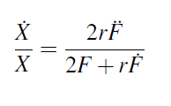
For empty space if we solve the Einstein Equation with the form of f (R) gravity , two independent field equations is found :
and dot means d/dr

Slide 39
After that choose our ansatzs with constants , and as :
Contstans is bounded by two constraints as :

Slide 40
After that this is obtained:
where
This will be very known solution of Schwarzschild when α or n is going to zero.

Slide 41
After using those constraints and definitions , an asymptotic form of f (R) where constant of integration is found as

Slide 42
Application in rotation curve
In weak field approximation, geodesic equation for a test particle that rotates around the central mass obtains as
where dot means d/dt
Substituting the corresponding metric elements we get the following velocity for a particle rotating around the center of galaxy up to the fist order of as

Slide 43
Here for we expand up to the first order of as rα to get the asymptotic velocity of stars in large distances from the center of galaxy as

Slide 44
In this solution asymptotic velocity depends on two parameters, and . I is related to n which is the power of R in the action , consequently it should be a small dimensionless number and
independent of mass, because it comes from the geometric part of action.

Slide 45
According to Tully-Fisher relation the forth power of asymptotic rotational velocity in large distance from the center of a spiral galaxy is proportional to mass of galaxy,

Slide 46
Then assumed that
in which μ is a proportional coefficient
with mass inverse dimension and M is
mass of galaxy. Therefore asymptotic velocity:
in which and μ will determine comparing with observational rotation curve data sets.

Slide 47
Suppose mass of galaxy is about
For an asymptotic velocity which equals to , it is obtained
This value recovers Tully-Fisher's relation, but we should test it with another acceptable theory such as MOND results.

Slide 48
Equivalence with MOND
In the beginning of 80's decade, MOND theory introduced by Milgrom and obtained many successes in description of DM in spiral galaxies (M. Milgrom, 2002). Until 2004 MOND theory did not have a relativistic description, when Bekenstein introduced a rigorous Tensor-Vector-Scalar (TeVeS) theory for MOND paradigm (J.D. Bekenstein, 2005).

Slide 49
Gravitational acceleration in MOND theory obtains as for
and for ,
where is Newtonian gravitational acceleration and is
MOND acceleration parameter.

Slide 50
In solution, gravitational acceleration in weak field approximation up to the first order terms in obtains
as
Therefore
which is in agreement of obtained value
from asymptotic velocity for a typicalgalaxy.

Slide 51
3.WIMPS Miracle
1. Thermal Production
WIMPs and many other dark matter candidates are in thermal equilibrium in the early universe and decouple once their interactions become too weak to keep them in equilibrium. Those particles are called thermal relics

Slide 52
As their density today is determined by the thermal equilibrium of the early universe. When the annihilation processes of WIMPs into SM parti- cles and vice versa happend at equal rates, there is a equilibrium abundance.

Slide 53
When the Universe cooled down and the rate of expansion of the universe H exceeds the annihilation rate, the WIMPs effectively decouple from the remaining SM particles.So the equilibrium abundance drops exponentially until the freeze-out point.The abundance of cosmological relics remained almost constant until today.

Slide 54
Calculations
Now we will see how the calculation of the relic density of WIMPs proceeds within the standard cosmological scenario.

Slide 55
If the candidate is stable or has a long lifetime, the number of particles is conserved after it decouples, so the number density falls like Specifically, we use the Lee-Weinberg Equation. It describes annihilation and creation of χ particles.

Slide 56
DECOUPLING
Decoupling of particle species is an essential concept for particle cosmology. It is described by the Boltzmann equation
Particles decouple (or freeze out) when
An example: neutrino decoupling. By dimensional analysis,
Dilution from
expansion
‾
‾
XX → f f
f f → XX

Slide 57
Lee-Weinberg equation
: the equilibrium number density of the relic particles
3Hnχ: the effect of the expansion of the universe
< σv > :the thermal average of the annihilation cross section σ multiplied with the relative velocity v of the two annihilating χ particles
other term on RHS is the decrease (increase) of the number density due to annihilation into (production from) lighter particles

Slide 58
The Lee-Weinberg equation assumes that χ is in kinetic equilibrium with the standard model particles
Now we use the effect of the expansion of the Universe by considering the evolution of the number of particles in a portion of comoving volume given by
We can then introduce the convenient quantity
such that

Slide 59
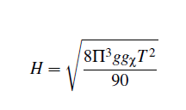
In addition, since the interaction term usually depend explicitly upon temperature rather than time, we introduce the x = m/T , the scaled inverse temperature.
During the radiation dominated period of the universe, thermal production of WIMPs takes also place . In this period, the expansion rate is given by

Slide 60
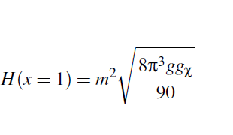
And then
Where and where denotes the number of
intrinsic degrees of freedom for particle.

Slide 61
Hence , last format of our equation is
where

Slide 62
After all little tricks , our Lee-Weinberg equation can be recast as
where

Slide 63
To integrate the Lee-Weinberg equation, we need to have an expression for the equilibrium number density in comoving volume.
Once the particle is non-relativistic, the difference in statics is not important.
The general equation of equilibrium number density in comoving volume is

Slide 64
For the nonrelativistic case at low temperatures T << mχ one obtains,

Slide 65
At high temperatures, χ are abundant and rapidly annihilate with its own antiparticle χ into the standard model particles.
Shortly after that T has dropped below mχ(T << mχ) ,the number density of χ drops exponentially, until the annihilation rate
Γχ =N(x) < σv > becomes less than the expansion rate H

Slide 66
The temperature at which the particle decouples (The time when the number of particles reaches this constant value) from the thermal bath is called freeze-out temperature TF .
Therefore χ particles are no longer able to annihilate efficiently and the number density per comoving volume becomes almost constant.

Slide 67
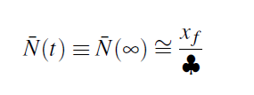
An approximate solution for the relic abundance is given by
and is freeze-out temperature and approximately, for the typical case
One has that is a solution of

Slide 68
We can then finally calculate the contribution of χ to the energy density parameter finding a well know result
It is intriguing that so called "WIMPS"(e.g. the lightest supersymmetric particle) dark matter particles seem to reproduce naturally the right abundance since they have a weak cross section

Slide 69
,and masses mx mew 100GeV .
This observations is called the "WIMP miracle" and typically considered as an encouraging point supporting WIMPS as Dark Matter candidates.

Slide 70
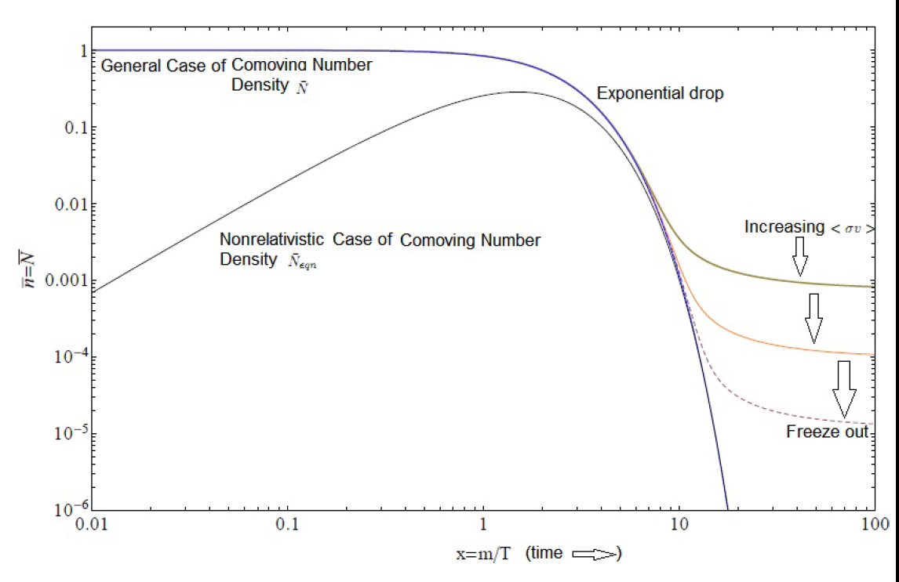
1) Initially, neutralinos χ are in thermal equilibrium:
χχ ↔‾ f f
2) Universe cools:
N = N_{EQ} ~ e ^{−m/T}
3) χs “freeze out”:
N ~ constant
Freeze out determined by annihilation cross section: for neutralinos, Ω_{DM} ~ 0.1; natural – no new scales!

Slide 71
Lee-Weinberg equation, the termal production, is the most traditional mechanism but that many other mechanisms have been considered in the literature such as non thermal produc- tion of very massive particles(so called WIMPZILLAS) at preheating or even right-handed neutrino oscillations.

Slide 72
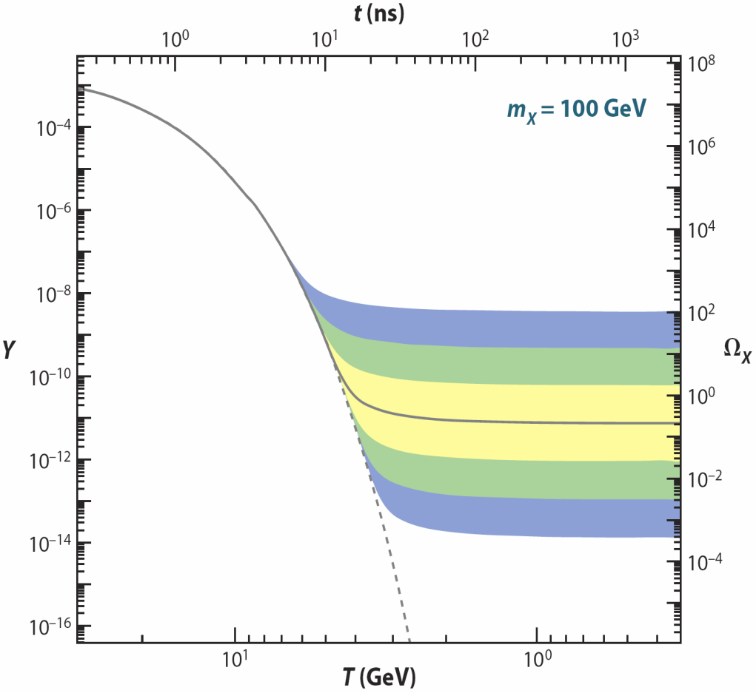
FREEZE OUT: QUALITATIVE
(1) Assume a new heavy particle X is initially in thermal equilibrium:
XX ↔‾ qq
(2) Universe cools:
XX ‾ qq
(3) Universe expands:
XX ‾ qq
(1)
Increasing
annihilation
strength
↓
(2)
←
(3)
/
→
→
/
←
/
Feng, ARAA (2010)
Zeldovich et al. (1960s)

Slide 73
WIMP EXAMPLES
Weakly-interacting massive particles: many examples, broadly similar, but different in detail
The prototypical WIMP: neutralinos in supersymmetry
_{Goldberg (1983)}
KK B¹ (“KK photons”) in universal extra dimensions
Servant, Tait (2002); Cheng, Feng, Matchev (2002)
Cosmology and particle physics both point to the Terascale for new particles, with viable WIMP candidates from SUSY, UED, etc.

Slide 74
DARK MATTER ANALOGUE
Particle physics → dark matter abundance prediction
Compare to dark matter abundance observation
How well can we do?

Slide 75
SUMMARY
Thermal relic WIMPs can be detected directly, indirectly, and at colliders, and the thermal relic density implies significant rates
There are currently tantalizing anomalies
Definitive dark matter detection and understanding will require signals in several types of experiments
f (R) extended gravity in which the effect of DM is
not due to exotic sources but due to the wrong choice of Lagrangian however, describes asymptotic behaviours of flat rotation curves and experimental
results of Tully-Fisher.

