Slide 1
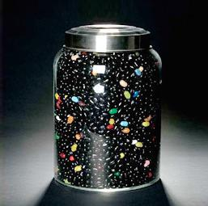
DARK SIDE OF THE COSMOS
Ali ÖVGÜN
Izmir Yüksek Teknoloji Enstitüsü

Slide 2
“Normal Matter”
4%
Dark Energy
73%
Dark Matter
23%
Notes:
Dark matter geçmişte baskınıdı, dark enerji ise gelecekte evrene şeklini verecek.

Slide 3
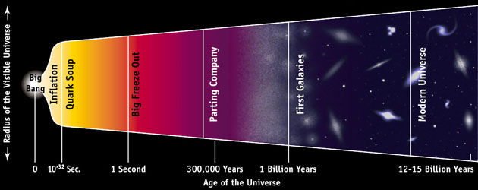
• George Le Maitre – Jesuit
priest/astronomer used general
relativity to construct a model of the
universe which began as a “primeval
atom” which exploded.
• Given the nickname (derisively), the The Big Bang
Notes:
The Big Bang
• If the universe is expanding, it must
have been (much) smaller in the past.
– It must have had a beginning.

Slide 4
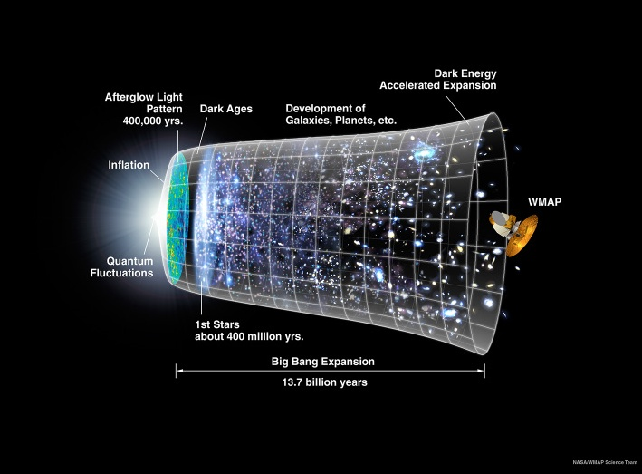

Slide 5
Evidence for Big Bang
Galactic redshift (universe is expanding)
Cosmic Background radiation
Observation of Helium which agree with the standard Big Bang model.
Obler’s paradox (1800’s)- why is night sky dark?

Slide 6
Olber’s Paradox
The Universe is Homogeneous and Isotropic
Stars and Galaxies are distributed uniformly throughout
If the universe is infinite in extent, every line of sight from the earth must eventually end at a star or galaxy. The sky should be bright, day or night.
BUT IT IS NOT!
Why?
• Heinrich Olbers, Swiss
astronomer, in 1826 asked
– Why is it dark at night?
• Look out in any direction
whatsoever in the sky. If the
universe goes on forever,
your line of sight will hit a star
sooner or later.
– Nights should be as bright as day
Notes:
Evren eğerki sonsuz olsaydı ozaman gece çıkıp gökyüüne baktığımızda mutlaka bir ışık gözümüze gelirdi ve gece aydınlık olurdu faka t bu böyle değil çünkü evren sonludur

Slide 7
Olber’s Paradox Resolutions
As you look farther (and fainter) you are looking back in time.
0. It is not infinite in extent. (violates Homo-Iso principle)
1. The universe is “young” or a finite age.
Therefore, there are lines of sight that don’t end in stars or galaxies. If you far enough back in time, there were no stars or galaxies.
2. The universe is expanding.
Therefore, photons experience redshift and the energy from all the receding sources is reduced. E = hν
3. BOTH 1. and 2. are true.
Notes:
Evrenin sonlu olmasıda olberts paradoxunun tam olarak dogrulamaz çünkü evren aynı zamanda genişliyorda bundan dolayı yayılan ışık redshiftden dolayı frekansı yani enerjisi azalıyor.bu genişlemed cmb oluşturuyor.çünkü genişledikçe soguyor... Ve sıcaklık düşüyor.

Slide 8
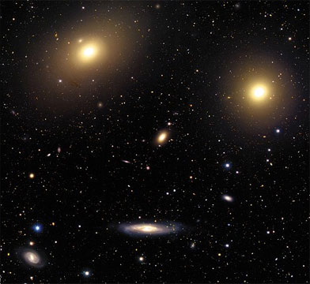
Testing the Big Bang model
Prediction: The universe is expanding
Observation: Galaxies are moving apart from each other (1929)
The universe does not expand into space – space itself expands
Extrapolating back, space was small – the Big Bang
Notes:
Büyük patlama dediğimiz nedir ve nerden çıktı? İşte büyük patlamanın da en büyük dayanaklarından biri evrenin genişlemesidir çünkü evren zaman ilerledikçe genişliorsa zamanın geriye sardığımızda küçülmesi gerekir ve sonunda bir singularitesi olan bir noktaya gelir.
Big Idea: evidence for an expanding universe
Further study of the motions of the galaxies by Hubble revealed that they were racing away from us and each other: proof of an expanding universe (1929).
Many people believe that the Big Bang is “just a theory” with no evidence to support it. In science, the word “theory” means an idea that is well-established and supported by scientific evidence. Hubble’s observations of galaxies moving apart from each other is one of SEVERAL lines of evidence that supports the Big Bang model.

Slide 9
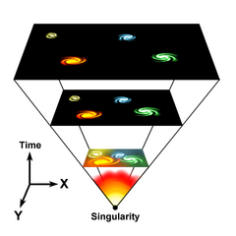

Slide 10
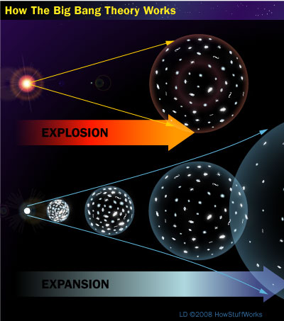

Slide 11
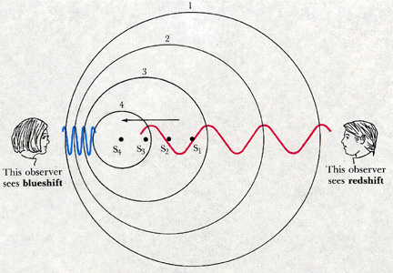
Using the Doppler Effect to Measure Velocity
Blueshift
Redshift

Slide 12
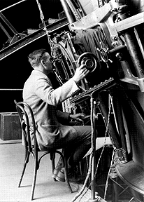
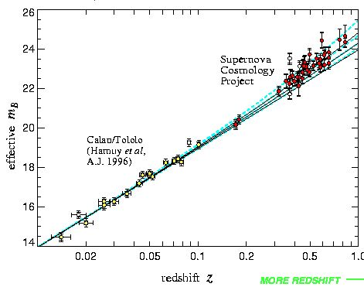
Edwin Hubble at Mt. Wilson
Hubble’s observations at the 100 inch during the
1920’s led him to the conclusion that the universe
is expanding, and that an object’s recession velocity
is proportional to its distance from the observer.
Hubble guiding the Hooker
100 inch telescope in 1923.
The Hooker 100 inch telescope atop Mt. Wilson
near Pasadena, CA. It was the largest telescope in the world from 1917-1947.

Slide 13
Hubble Law
V_{r} = H₀ D
V_{r} = radial velocity
D = Distance
H₀ = slope of linear relationship
(Hubble constant)
V_{r}
D

Slide 14
An Expanding Universe
The consequence of Hubble’s Law is
most galaxies are moving away from us
if all galaxies swarm out through a void
then the Milky Way is at the center of the Universe? NO!
The Universe itself is expanding.
the galaxies expand with it
there is no center or edge to the Universe
From any galaxy’s point of view, other galaxies are all moving away from it.
Notes:
Çogu galaxyler bizden uzaklaşıyor eğer bu galaxi kümeleri bizden kaçıorsa biz evrenin ortasındamıyız? Hayır. Değiliz. Evrenin bir merkezi diye birşey yoktur. Galaxyler kendileri ile genişliorlar.her galaxye göre diğer galaxiler kendinden uzaklaşıor gibi gözükür.

Slide 15
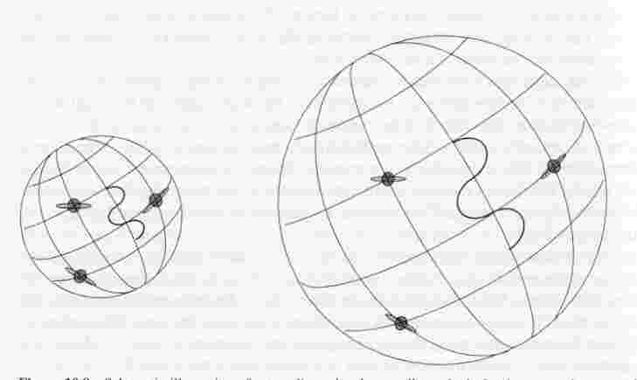
Hubble Flow
Coordinates do not change
There is no center to the expansion, everyone moves away
Photons (~) are seen to redshift by the expansion of space-time
Notes:
Evren gördüğünüzü gibi genişlior ve bize gelen ışık yani foton tanecikleri uzayın genişlemesinden dolayı uzak yoldan geldikleri için dalga boyu artıor ve enerjisi aynı oranda azalıor.bu aslında çok kolay gibi gözüküor ancak öyle deil.

Slide 16
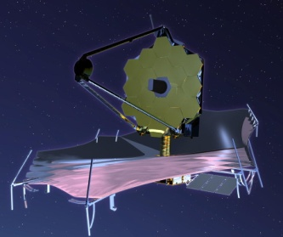
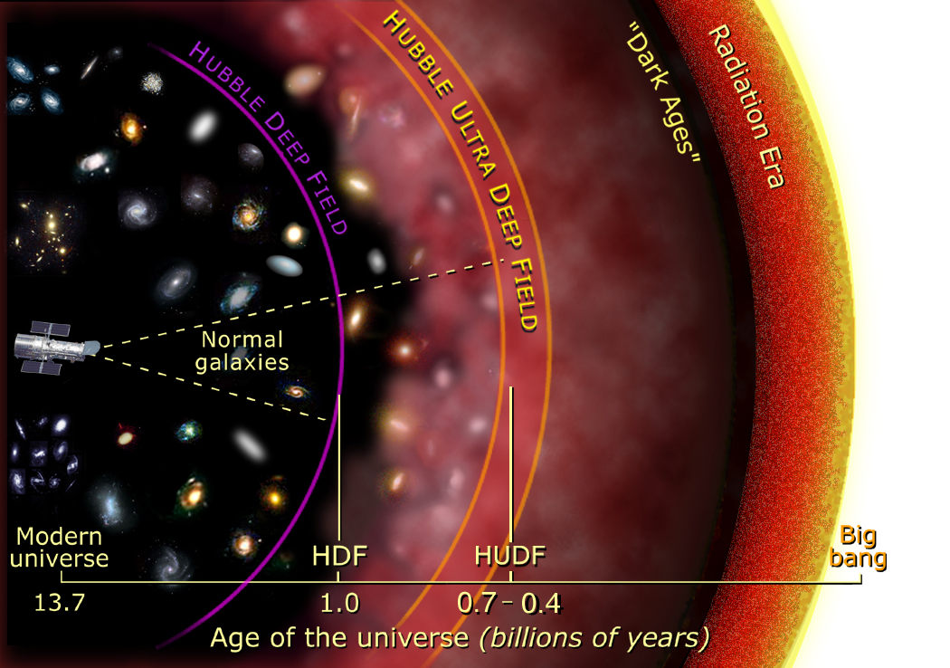
End of the dark ages
7% of the age of the Universe
Notes:
Bildiğiniz gibi güneşten çıkan bir photon bize ancak 8 dakika sonra gelior yani biz herzaman güneşin 8dakika önceki haliniz görüyoruz , bu daha uzak cisimler için de geçerli.

Slide 17
Hubble Constant
V_{r} = H₀D
H₀ = Hubble constant
= 60-80 km/s/Mpc
Units for 1/H₀ = seconds
This is an age estimate for our universe.
The true age should be less than this
It is a maximum age estimate because matter has
surely(?) caused some amount of deceleration.

Slide 18
How Old is the Universe?
1644: Dr. John Lightfoot, Vice Chancellor of Cambridge University, uses biblical genealogies to place the date of creation at September 21, 3298 BC at 9 AM (GMT?)
1650: James Ussher, Archbishop of Armagh and Primate of All Ireland, correlates Holy Writ and Middle Eastern histories to “correct” the date to October 23, 4004 BC
Current Jewish calendar would “suggest” a date of creation about Sep/Oct 3760 BCE
Notes:
Chancellor: rektör

Slide 19
How Old is the Universe?
Which one is true???
The age of Earth is ;
The Old Testament : Sep/Oct 3760 BCE or
Science: 4.3x10⁹ years
1760: Buffon uses cooling of Earth from its molten state to estimate age as 7.5x10⁴ years
1831: Charles Lyell uses fossils of marine mollusks to estimate age as 2.4x10⁸ years
1905: Lord Rutherford uses radioactive decay of rocks to estimate age as > 10⁹ years (later refined to 4.3x10⁹ years)

Slide 20
The Age of the Universe
Our best measurement of the Hubble Constant…
comes from the Wilkinson Microwave Anisotropy Probe
announced by NASA in February 2003
H_{o} = 71 km/s per Mpc
So, the age of the Universe, 1/H_{o} = 13.7 billion years

Slide 21
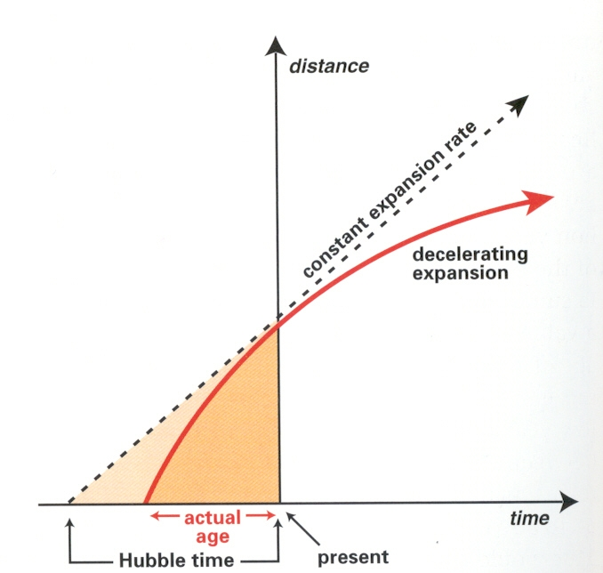

Slide 22
H = H(t)
Has expansion remained constant throughout time?
Until recently the expansion was thought to have been slowing
down due to the matter in the universe gravitationally
breaking. But recent results suggest acceleration is occurring.
H₀ = H(t_{now})
The Hubble constant is not a fundamental constant,
it is variable with time.

Slide 23
The Big Bang
• If the universe is expanding, it must
have been (much) smaller in the past.
– It must have had a beginning.
• George Le Maitre – Jesuit
priest/astronomer used general
relativity to construct a model of the
universe which began as a “primeval
atom” which exploded.
• Given the nickname (derisively), the The Big Bang

Slide 24
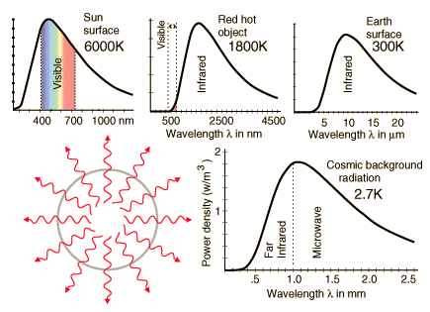

Slide 25
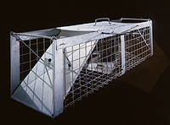

Slide 26
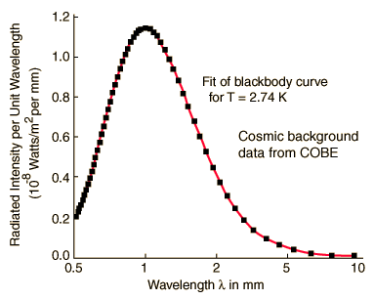

Slide 27
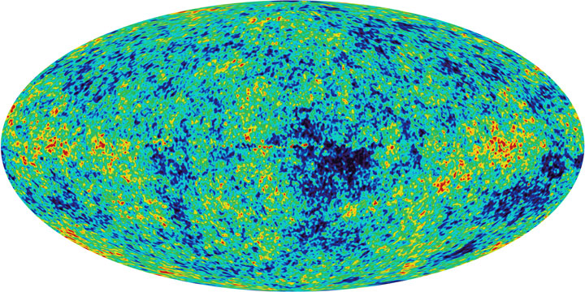
Testing the Big Bang model
Prediction: If the universe was denser, hotter, in past, we should see
evidence of left-over heat from early universe.
Observation: Left-over heat from the early universe. (Penzias and Wilson, 1965)
Notes:
Big Idea: evidence for the Big Bang model - leftover heat from the early universe
If you run the expansion of the universe backwards, there comes a time when the universe becomes very hot, dense and opaque - like living inside the Sun. The light from this time - 13.7 billion years ago, still bathes the cosmos. Originally at 3000K, it has now cooled to 3K, and can be detected by sophisticated radio telescopes such as WMAP (Wilkinson Microwave Anisotropy Probe).
Like Hubble’s observation of galaxies moving apart from each other, the discovery of this leftover heat is another line of evidence that supports the Big Bang model.

Slide 28
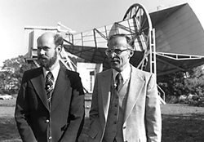
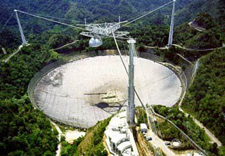
Discovery of the Background Radiation from initial Big Bang
-Long wavelength
-came from all directions
Penzias and Wilson, 1965
Arecibo Dish, Puerto Rico

Slide 29
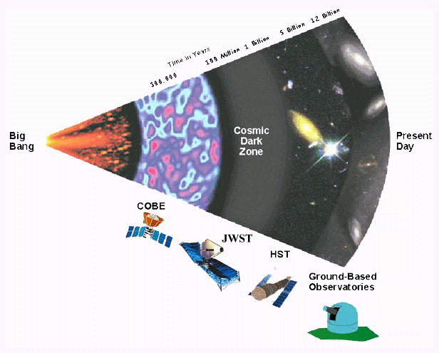

Slide 30
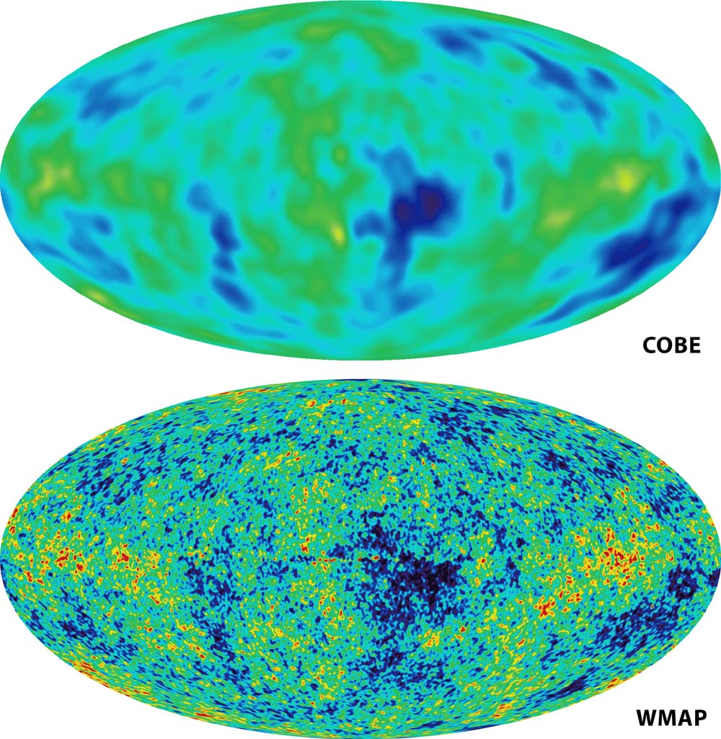

Slide 31
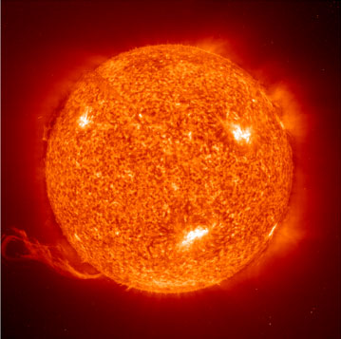
Testing the Big Bang model
Prediction: A hot, dense expanding universe, should be
predominantly hydrogen, helium.
Observation: Universe is ~75% hydrogen, ~25% helium by mass
The Sun: 74.5% H, 24% He by mass
Cecilia Payne
Notes:
Big Idea: evidence for the Big Bang model - composition of the universe.
The simplest of atoms, hydrogen, gets cooked into heavier elements at a high enough temperature and density (such as the cores of stars). In the early hot and expanding universe, this fusion process only has time to cook hydrogen to helium (plus a little lithium) before the expansion and cooling shuts down the nuclear furnace. All elements above helium in the periodic table are created in the life cycles of stars. The theory is 12:1 ratio hydrogen to helium by number, or 75% 25% by mass, from the Big Bang. Exactly what is observed. The chemical composition of stars (and the fact that they were predominantly hydrogen) was determined by Cecilia Payne (1925)
The composition of objects in the universe is one of several lines of evidence that supports the Big Bang model.
(Note: In 1925 Cecilia was the first person to receive a Ph.D. in astronomy from either Radcliffe or Harvard University, and the first person to receive a doctorate using work done at the Harvard Observatory. In 1934 she married Sergei Gaposchkin and hyphenated her name.)

Slide 32
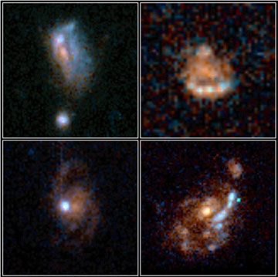
Testing the Big Bang model
Prediction: An expanding universe is evolving over time. If we look at the early universe, it should appear different.
Observation: Distant galaxies less evolved, physically and chemically.
Notes:
Big Idea: evidence for the Big Bang model - early galaxies look different.
Looking out in space is looking back in time. Distant galaxies therefore appear as they did in a less evolved universe. These early galaxies are more disturbed because of collisions with other galaxies, smaller and contain fewer heavy elements (“heavy element” is an astronomer’s expression for all elements other than hydrogen and helium).
Note to the presenter, if asked about the statement “looking out in space is looking back in time”: light takes time to travel through space. When light leaves an object it carries information about what the object looks like when the light left it. The further away an object it, the longer it takes to reach our eyes and telescopes. Therefore light that has been traveling from very far away carries information about what that objects looked like very long ago.

Slide 33
Cosmological Principle
At any instant of time, the universe must look homogeneous and isotropic to any observer.
Perfect Cosmological Principle
…….and indistinguishable from the way it looked at any other instant of time.

Slide 34
Steady-State Theory
The expansion of the universe is balanced
by the spontaneous production of bubbles
of matter-anti-matter, so that the Perfect
Cosmological Principle is preserved.
Nucleosynthesis in stars can account for
the abundances of all the elements except
the very lightest – is that a problem?

Slide 35
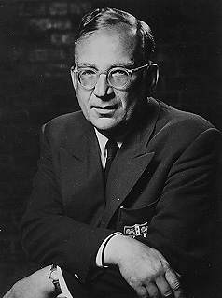

Slide 36
Gamow’s Test for a Big Bang versus a Steady State Universe
If there was a Big Bang, there should be some cooling remnant radiation (now maybe 5K?) that pervades the universe
If, instead, the universe is always the same, there should NOT be any cooling radiation

Slide 37
… but the equilibrium is unstable. In order to prevent the universe from either expanding or contracting, Einstein introduced a scalar field that was called
The Cosmological Constant
in order to keep the universe static.

Slide 38
Plank Time
The first instant of time (until 10⁻⁴³ s) is known as Plank time.
This era was governed by quantum gravity
Not understood.

Slide 39
Four Forces in Nature
Matter as we know it did not exist at the time of the Big Bang, only pure energy. Within one second, the 4 fundamental forces were separated
gravity - the attraction of one body toward another
electromagnetic force - binds atoms into molecules, can be transmitted by photons
strong nuclear force - binds protons and neutrons together in the nucleus
weak nuclear force - breaks down an atom’s nucleus, producing radioactive decay
The standard model describes three of these four but fails to describe gravity
The quantum theory of gravity is one of the big problems in current research. (some ideas)

Slide 40
The Matter/Anti-matter Problem
Why doesn’t there appear to be as much
antimatter as ordinary matter in the universe?
There is!
(or at least there was!)
In the early universe, the imbalance was less
than one part in 10¹⁰, so that when all the stuff
in the dense early universe annihilated it left a
small residual of matter and all those photons!

Slide 41
So What’s the Problem(s)?
The horizon problem
How did the universe become so homogeneous on large scales?
The flatness problem
Why is density of the universe so close to the critical density?
The magnetic monopole problem
Is there any particle with monopole magnetic?
Notes:
1: Parçacıklar ve radyasyon aynı hızlan yayılmaya başlaycaklar ve içlerinden hiçbiri ışık hızını geçemeyceğininden ilerden ya da geriki bir zamandan gelen parçacıklarla etkileşime giremez yani homojen olması gerek.
2:evren çok yüksek skalalarda düzdür.çünkü genişleme oranı ve enerji yogunlugu arasında bir denge var.Bir balon düşünün içinde eğer az hava varsa balonun dışı kıvrım kıvrım olur düz olmaz ama eğer balon şişerse düz gibi gözükür.
3: Sadece north yada south kutubu olan bir parçacık bulamazsınız.Elektrik monople var artı yada eksi bulabilirsiniz symetri kırıldığında.Single Grand unification kuvveti(em+strong+weak) oluştugunda çok sayıda ağır kütleli magnetic monopol parçacığı oluşması gerekiyor fakat yok.
İnflation sırasında monopolelerin yogunlugu çok düştü o yüzden bugün gözlemleyemiyoruz.

Slide 42
Inflation
Theory was created in 1980’s by Alan Guth
Basic Idea: Universe underwent tremendous growth (10³⁰ times its original size) during the time when the Strong force was “frozen out” from GUT.
Notes:
Bigbang tünnelleme..
Wmap sonuçları bize 1980lerde inflation teorisinin kabul edilmesini sağladı.sonra 1990larda hot bigbang ve dark energy hipotezleri atıldı.
Enflasyın teorisi: evren nokta halinden 10^100 katı boyunca genişledi ve bu sadece 10^-30 saniye aldı.Bu süreç bitince yogun radyasyonal gaslar oluştu sonra evrenin genişlemesi ile gaslar sogudu ve galaxyler yıldızlar oluştu.

Slide 43
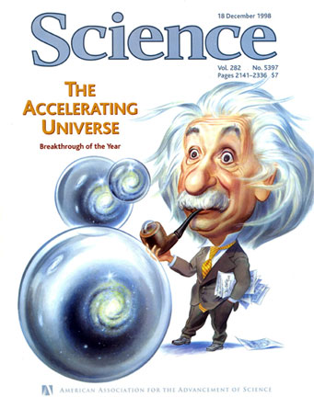
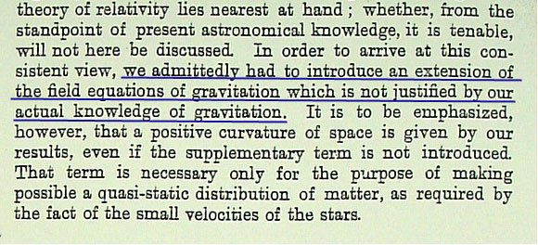
Observation: Expansion is accelerating.
Refine: Extra energy content.
A recent discovery and of unknown
origin,the concept of Dark Energy is
actually an integral part of Einstein’s
theory of gravity.
Notes:
Friemanın( Gr denklemleri İzotropik ve homojen enerji dağılımıyla çözümü) evreninde evrenin lamda ve omega degerlerine baglı olarak genişleyip yada büzülebileceği öngörülür , de sitterinkinde(lamdayı artı alıp çözünce einstein eqn.ı) ise evrenin genişlemesinin nedeninin denklemlerin sonucunun önerdiği vacuum enerjisinin yarrattığı negatif basınçtan oldugunu önerir.Ve bu vaccum enerjisinin oldugunu da casimir effect denen bir olayla kanıtladılar.
Big Idea: Dark Energy and how it fits into the Big Bang model
Supernovae in distant galaxies are further (so dimmer) than they should be, thanks to an accelerating universe.
70% of the energy content of the universe is contributed by “dark energy.” The energy of space, or vacuum energy, was a prediction of Einstein’s theory, and therefore an integral part of the Big Bang model. (26% is dark matter, 4% normal matter. When adding up the contents of the universe, we must add matter and energy together).
(Click for image on lower left) When Einstein first introduced this factor there was no observational evidence to support the idea. The next 5 slides explore the recently acquired evidence in more depth.

Slide 44
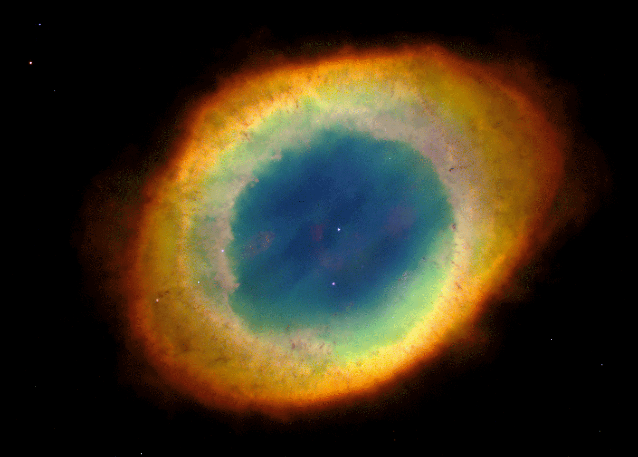
Evidence for Dark Energy - supernovae as distance indicators - step 1
A dying star becomes a white dwarf.
Notes:
Wmap ve 1998deki type1 supernova 1a gözlemleri yakındaki ve uzaktaki patlayan yıldızların bize evrenin hızlanarak genişlediğini gösterir. Ve Evren sonsuza kadar genişleyecek ve perfect vacuum oluşacak.
Slide 1 of 5 about Type 1a supenovae. Big Idea: setting the stage for the supernova - creating a white dwarf.
There are different types of supernova, but the type we are interested in comes from a star like our Sun. When the Sun runs out of its nuclear fuel in about five billion years time, it will go through a beautiful death ritual, shedding its outer layers in a blaze of color while its inside squeezes down into a dense white hot ball about the size of the Earth. This ball, aptly named a white dwarf, is where the story ends for the Sun, but not so other white dwarfs. About 2/3 of all stars in a galaxy live in pairs (called binaries), a union that becomes dangerous when one of the pair turns into a white dwarf.
This image shows the Ring Nebula, Messier 57, with the white dwarf remnant at its core.

Slide 45
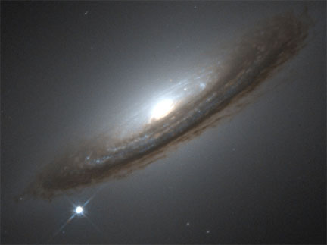
Evidence for Dark Energy - supernovae as distance indicators - step 4
The explosion is as bright as an entire galaxy of stars….
Notes:
Slide 4 of 5. Big Idea: Supernova
A supernova can shine as bright as a billion stars for several days, rivaling an entire galaxy of stars. This image shows a type Ia supernova explosion in the galaxy NGC 4526. Because the explosion is just a point of light in the sky looks like a star. The processes and conditions that create this type of explosion are effectively identical for each white dwarf supernova, so the event has a predictable, and reproducible, brightness. This makes them ideal distance indicators - the fainter they are the further they are.
By measuring the brightness of the supernova flash in NGC 4526, the distance to the host galaxy can be calculated. Note to the presenter: a discussion of how this distance is determined (I.e. how we know it is “further away than it should be”) is not required, but if asked, you can use the comparison of a flashlight. This type of supernova has a known brightness (like a flashlight with a certain watt bulb) and can only be that bright. Just as a flashlight shining from further away appears dimmer than one nearby, measuring the light from this type of supernova tells scientists how far away it is.

Slide 46
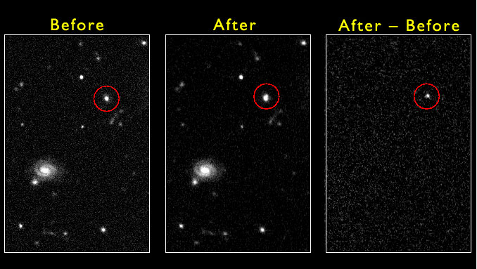
Evidence for Dark Energy - supernovae as distance indicators - step 5
…..and can be seen in galaxies across the universe.
Notes:
Slide 5 of 5. Big Idea: How scientists detect the supernovae
By carefully subtracting the two images using powerful computer software, supernovae can be found in distant galaxies. The light from one of these distant galaxies has increased since the first image was taken. What is left after the subtraction is the light from a Type 1a supernova. The brightness of the supernova gives an accurate measure of the distance to its galaxy.
The distance of the galaxy can also be found from the redshift (see slides 14 to 20) The distance by redshift is based on how fast the universe is expanding. The distance by supernova is and actual physical distance based on the inverse square law of light. Analysis reveals that this galaxy is further away than it should be for its redshift.
With a large collection of supernova observations at different distances, a history of the expansion of our universe can be constructed. It shows that, for the first eight billion years, the expansion rate was slowing. Then, around five billion years ago, the expansion started to speed up. This is the strongest piece of observational evidence for Dark Energy.

Slide 47
Future fate of the dark energy
Without dark energy, the destiny of the universe was tied to the geometry in
a simple manner: the universe will expand forever if it is open or flat. It will stop expanding
and contract to a Big Crunch if it is closed.
With Dark Energy, this connection between geometry and destiny is lost and the future
fate depends entirely on how the presently-dominant dark energy will evolve.
Notes:
Galaxylerin ilk oluştugu anda Dark energy yogunlugu normal madde yogunlugundan çok küçüktü fakat evren genişaledikçe galaxyler yayıldı ve gravity yogunluhu azaldı fakat dark energy yogunlugu azalmadı ve normal madde yogunluguna baskın oldu buda evrenin hızla genişlemesine neden oldu.
Önemli olan evrenin ivmelenerek genişlemesi.Gözlemlere göre ivmelenme 5 milyar yıl önce başladı. Ve Friedman denklemlerine göre şimdiden itibaren her 10 milyar yılda evrenin boyu 2 kat artacak.

Slide 48
First Few Minutes
The Four forces were united
The early universe was extremely hot
So hot that the photons had enough energy such that they could collide and produce electron-positron pairs
These pairs would then re-annihilate and form photons.
Notes:
İlk başta Inflation-Radiation dominant-matter dominant-dark energy dominant

Slide 49
GUT Era
After the plank time gravity became a separate force but remaining three were still united.
Think gravity was “frozen out” of the unified forces
Remaining three united forces termed GUT (Grand Unified Theory)
Universe grew very quickly at this point (Inflation)
lasted until 10⁻³⁶ s universe at 10²⁹ K.

Slide 50
Electroweak Era
Then strong force separated from the GUT force.
Leaves three forces
Gravity
Strong
Electroweak
Universe at 10⁻¹⁵ K lasted until 10⁻¹⁰ s
Theories are still not strong here

Slide 51
Particle Era
Finally temperature of universe lowered such that particles could be formed
as shown earlier.
at first only quarks and leptons. Termed quark-gluon plasma.
Then around 1 millisecond protons and neutrons could form
Temp drops below 10¹² K.

Slide 52
Nucleosynthesis and era of nuclei
From 0.001 seconds until 3 minutes universe underwent fusion
75% of baryonic matter became ¹H
25% became heavier H isotopes, He, and Li.
Era of Nuclei
for next 500,000 years universe cooled until galaxies could form.
Era is observed today in the form of Cosmic Background radiation

Slide 53
Future of Universe
The universe’s future depends upon how much matter is present
There is a critical density of the amount of matter in the universe which will determine if the universe is going to collapse on itself or will expand forever.
This is often expressed in terms of the Greek letter - omega

Slide 54
Future of Universe
The standard models give our universe three choices:
Omega > 1 : Universe will collapse on itself ( closed)
will end in big crunch
Omega=1 : Universe will slowly stop expanding (flat)
Omega <1 : Universe will continue to expand forever (open)

Slide 55
Future of Universe

Slide 56
Future of Universe
But recent (within last 4 years) observations have shown that the universe is not obeying any of these models.
Observations of distant Type 1a SN have shown that universe is accelerating
Strangely enough this brings Einstein’s cosmological constant into play.
Perhaps one of most exciting fields in physics
Leading theories claim this is due to “dark energy”
a force which we know less about than even dark matter.

Slide 57
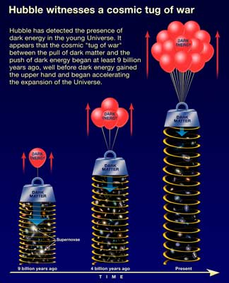

Slide 58
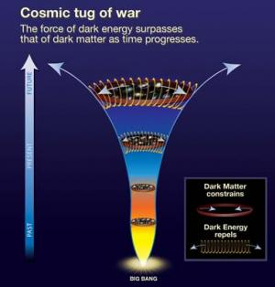

Slide 59
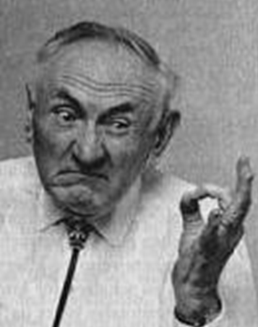
Galactic Rotation Curves
For a star of mass m a distance r from the center of
a galaxy, where the total mass interior to r is M(r):
mv²/r = GM(r)m/r²
so that we would expect
v= [GM(r)/r] ^{½} so that v should go like r ^{-½}

Slide 60
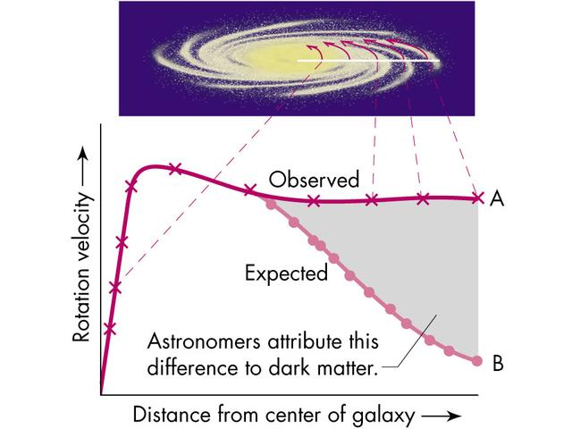
Notes:
Needs for an extra component which does not emit visible light
Kepler law indicates that the M(r) is increasing with r
First evidences found in 30’ by:
Jan Oort from stellar motions and Zwicky in galactic clusters

Slide 61
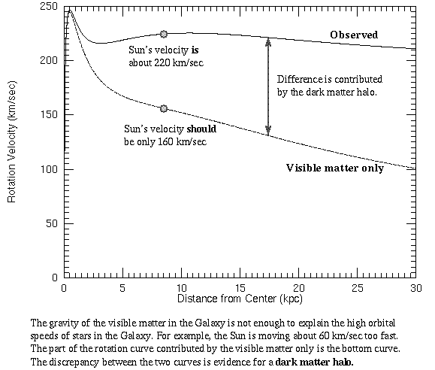

Slide 62
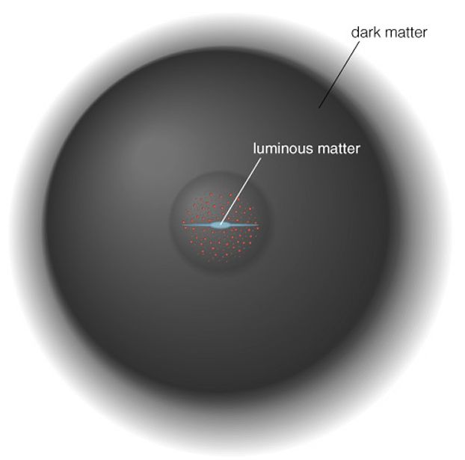

Slide 63
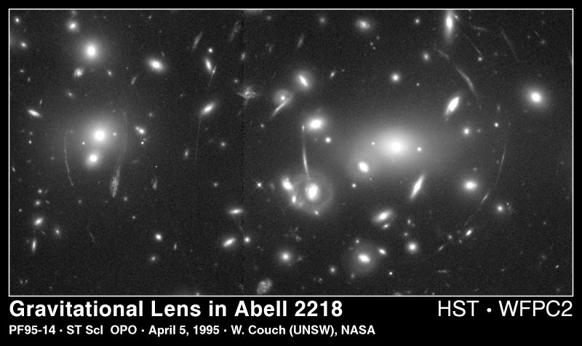
Evidence
Gravitational lensing
Notes:
Yada 1930larda Fritz Zwick galaxy kümelerinde hızlı hareket eden galaxyleri incelerken ki bunları bir arada tutan gravitydir,, çok hızlı dönmesinin nedeninin kütlesinin gözlemlenenden fazla olması gerektiğini düşündü.Fakat bu gözüken madde miktarıyla eşit değil. 1980lerde gravitational lensing yani gravitasyonal alanda ışıgın sapma etkisini kullanarak dm oldugunu kanıtladılar.

Slide 64
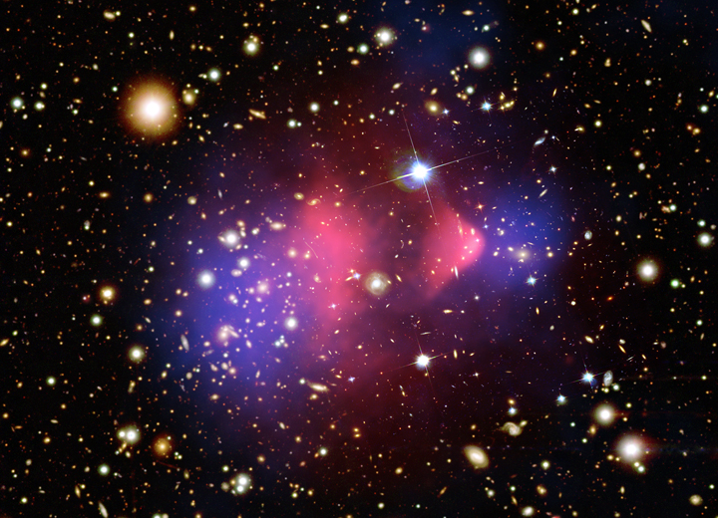
Direct Proof of Dark Matter
Two large clusters of galaxies (blue )
Notes:
The mass of the hot gas between the galaxies is far greater than the mass of the stars in all of the galaxies. This normal matter is bound in the cluster by the gravity of an even greater mass of dark matter. Without dark matter, which is invisible and can only be detected through its gravity, the fast-moving galaxies and the hot gas would quickly fly apart. The hot gas in this collision was slowed by a drag force, similar to air resistance. In contrast, the dark matter was not slowed by the impact, because it does not interact directly with itself or the gas except through gravity. This produced the separation of the dark and normal matter seen in the data. If hot gas was the most massive component in the clusters, as proposed by alternative gravity theories, such a separation would not have been seen. Instead, dark matter is required.

Slide 65
So what is it?
Strong bias towards a particle physics solution!
BUT still room for modifying gravity especially
given the cosmological constant
Particle Physics point of view
Does not shine in the visible domain: Neutral
Observed nowadays: Stable or quasi stable
Silk damping: Weakly interacting.
Weak means weaker than electromagnetic/strong interactions BUT could be stronger than the Standard weak interactions

Slide 66
What kind of particles can it be?
Invisible baryons???
SM particles (higgs, neutrino)???
New particles (Thermal / non-thermal)???
(Others: long range scalars - fluid,..)

Slide 67
Invisible baryons?
would suffer from the Silk damping effect and lead to the ``wrong’’ linear P(k).
Unless perhaps one modifies gravity!
but the amount of baryons is limited by nucleosynthesis.
Besides looked for by MACHO&EROS in our galaxy: too small component!

Slide 68
Standard Model particles?
Higgs?
Non stable! (if it exists..)
Neutrinos?
Could be but they free-stream.
Their mass needs to be > 20 eV but the current bound is only 2 eV * 3.
sterile neutrino maybe??? (small keV window?)
Notes:
Bundan dolayı az miktarda ve çok kütleli olmalı fakat neutrinolar ışık hızına yakın hızlarda gider bu kadar kütleli birşeyin bu kadar hızlı gitmesi imkansız.

Slide 69
New particles
Thermal
Neutralinos, sneutrinos (ruled out)
Kaluza-klein
Light dark matter
….
Non-thermal
Axions
Gravitinos
Wimpzillas, ….

Slide 70
Notes:
Mond yani modifiye edilmiş newton dinamiği bunu 1983 yılında bir İsrailli olan Milgrom ortaya attı.Galaxylerin rotationallarını inceledi ve dark mattera gerek yok dedi.Newton yasalarının çok düşük ivmelerde değişmesi gerektiğini öne sürdü.Gravity çok düşük ivmelerde çok kesinlikte gözlemlemek ve ölçmek zordur o yüzden deneysel olarak gösterilemedi.Bir sabit ekledi newton denklemine ve bu sabitte böldü yai böylece kuvveti düşürdü kuvvet azalıncada rotasyonal hız azaldı yani grafiğii fitledi.Fakat burdaki esas sorun Galaxylerin boyu değiştikçe bu sabitin değişmesi. Ve büyük galaxy kümelerinde ,mondu kullansanızda yinede olması gereken kütle miktarını bulamıyorsunuz .Yani kayıp bir madde var.Hem dark matter hem Mond ama olabilir.Ayrıca Mondu milgrom sadece newton denklemlerine uyguladı.Bunu GR ye Berkenstein adlı bir meksikalı 2004te uyguladı onun yaptıgı gözlemsel sonuclarla tutarlı fakat yine kütle problemini çözmede yetersiz.Oxfordtaki bir grupta bu kütle problemini çözmek için neutrinoları kullandı.

Slide 71
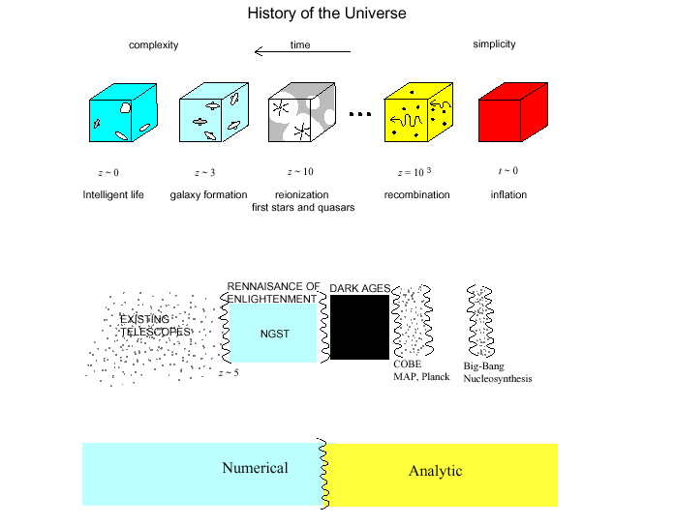

Slide 72
Salient Features of the Universe
• Homogeneity and isotropy for 6000 Mpc > x > 100 Mpc
• Universe expanding uniformly
• thermal background of radiation with T~3K
• chemical composition is roughly 75% H, 25% He, + trace
• ordinary matter is more abundant than ordinary antimatter
• nearly scale invariant, adiabatic CMB fluctuations
• universe is spatially flat
• hierarchy of lumpy structure from 1 kpc to 100 Mpc scales
• ordinary matter is a minority (1/6x) of all matter
• matter is a minority (1/4x) of all energy
• expansion rate is accelerating

Slide 73
Best evidence: we exist !

Slide 74
Looking for some problems?
What is the nature of dark matter?
What is the nature of dark energy?
What is origin of supermassive black holes?
What role does dark energy and cosmic acceleration play?
Why is the cosmological constant so small?
What is the origin of matter-antimatter asymmetry?
Is the inflationary theory correct? (or the cyclic?)
What is the inflaton or cyclic field responsible?
How far does space extend?
Is the Big Bang a beginning of space and time?
Why are there three large spatial dimensions?

Slide 76
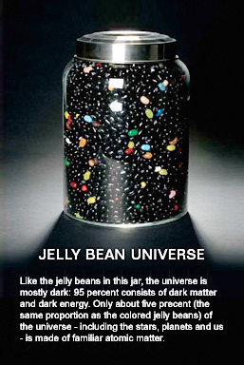

Slide 77
“Normal Matter”
4%
Dark Energy
73%
Dark Matter
23%
Notes:
Big Idea: Composition of the universe
Astronomers are able to determine how much dark energy there is based on the measured rate of expansion of the universe. They are able to do this because Einstein's theory of gravity relates the expansion rate of the universe to the total amount of all forms of mass or energy in the universe.
The result is that about 73% of the content of the observable universe must be dark energy. In other words, most of the universe is made of some mysterious form of energy whose nature is completely unknown.

Slide 78
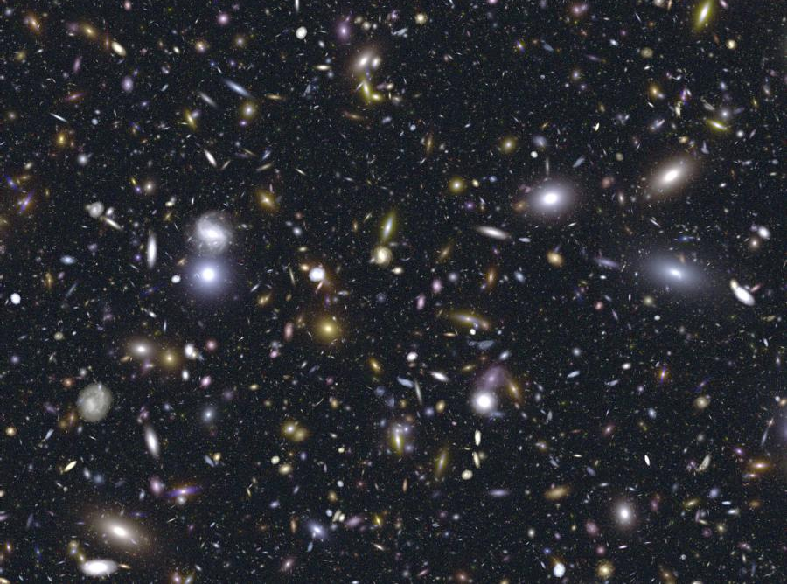

Slide 79
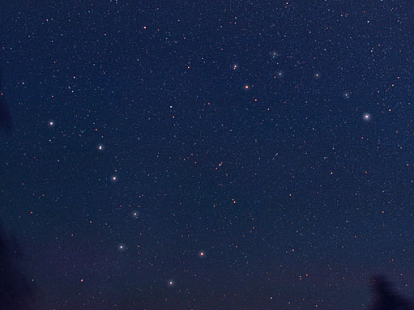

Slide 80
THANK YOU

